Slide 1
Writing scientific papers:
Chose your publication outlet wisely
Prof. Stefaan De Neve
Department of Environment
Ghent University, Belgium

Slide 2
Contents
Different types of scientific papers
Choice of journal
    Relevance of journal for your field
    Impact and impact factors
    Time of choice
    Publication charges
Predatory journals: beware

Slide 3
1. Different types of scientific papers
  Abstract for conference
  Extended abstract for conference
  Full conference paper
  Regular research paper
  Review paper - Meta analysis

Slide 4
1. Different types of scientific papers
Abstract for conference
Hier een scan van een conference abstract inplaatsen

Slide 5
1. Different types of scientific papers
Extended abstract for conference
Hier een scan van een extended conference abstract inplaatsen

Slide 6
1. Different types of scientific papers
Full conference paper
Hier een scan van paar bladzijden full paper plaatsen, of enkel eerste blad of eerste 2 bladen

Slide 7
1. Different types of scientific papers
Regular research paper
Hier een scan van eerste blad van een van mijn papers plaatsen
Voluntary publication of original research in a journal matching the research topic, or in a multidisciplinary journal

Slide 8
1. Different types of scientific papers
Review paper - Meta analysis
Hier een scan van eerste blad van review paper plaatsen
A systematic review is a detailed, systematic and transparent means of gathering, appraising and synthesising evidence to answer a well-defined question.
Most difficult type of paper! A good review paper takes many months or even several years to write!

Slide 9
1. Different types of scientific papers
Review paper - Meta analysis
Systematic review seeks to reduce bias at all stages of the review process.
The stages in conducting a review are:
  Clearly define your question
  Specify your proposed methodology in advance in the form of a protocol
  Conduct a thorough search of the literature
  Screen your search results against your pre-specified selection criteria to identify included studies
  Appraise the quality of studies found
  Synthesise the evidence (this is where meta-analysis may or may not come in)
  Publish your review
Notes:
You can see that a systematic review involves much more than simply putting some statements and numbers together. It is a detailed, transparent and sometimes (often) time consuming process.

Slide 10
1. Different types of scientific papers
Review paper - Meta analysis
A meta-analysis is a statistical procedure for combining numerical data from multiple separate studies. A meta-analysis should only ever be conducted in the context of a systematic review.
Increasingly popular, but many meta analytical papers are flawed by methodological/statistical errors

Slide 11
1. Different types of scientific papers
What are the main differences between these types of publications in terms of the review process?
  (Extended) abstracts: often no real review, quick check of acceptability (maximize #participants!). Almost only used to decide on type of presentation (plenary oral, oral, poster)
  Full conference paper: if peer reviewed, often superficial and more a formal check than a true check of scientific value/rigour
  Regular research paper: normally peer reviewed, but review rigour is extremely variable
  Review paper: as regular research paper

Slide 12
1. Different types of scientific papers
Abstract for conference
Extended abstract for conference
Full conference paper
Regular research paper
Review paper - Meta analysis
Writing efforts
Impact
Impact

Slide 13
2. Choice of journal – Relevant journal for your field
Look at the scope of the journal!
If the journal is only marginally relevant for what you have published, impact will be small
Usually you know the good journals in your field - Let us look at some journal lists in JCR right now!
Top journal in your field ↔ Multidisciplinary journals: Scientific Reports, Nature, Science, PNAS

Slide 14
2. Choice of journal - Impact and impact factors
What is impact of a paper??
Is your paper of such a quality and relevance that:
  many people will read it?
  many people will cite it?
  people will contact you to get more information?
  people will contact you to collaborate on this topic in a project?
  → “Objectivized” in metrics: # citations

Slide 15
2. Choice of journal - Impact and impact factors
What is impact of a paper??
  → “Objectivized” in metrics: # citations
Journals publishing papers that are cited rapidly and frequently will have a high “impact factor” or “IF”
Your paper will very likely have more impact when published in a journal with high IF!
There are different types of impact factors – what counts? SORRYSORRY SORRY but … : the ISI impact factor from the Journal Citation Reports database is the only thing that truly counts internationally!
Notes:
Go to JCR here and show for soil journals

Slide 16
2. Choice of journal – Timing of choice
Ideally before starting to write the paper (save time)
  You CAN do it after completion of the manuscript but then risk of having to rework completely (actually most common)
    Instructions for authors!

Slide 17
2. Choice of journal – Publication charges
  Can range from 0 to 1000’s of Euros
  In my group we publish practically everything for free!
  Having to pay publication charges is often not a very good sign …
  Most good quality journals in most disciplines, and most top multidisciplinary journals do not charge the authors!
  Who pays then? Right, the reader
See also predatory journals!

Slide 18
3. Predatory journals

Slide 19
3. Predatory journals
Be aware: predatory journals and the pitfalls of publishing there
Characteristics of predatory open-access publishing include
Accepting articles quickly with little or no peer review or quality control, including hoax and nonsensical papers.
Poor English on the journal website
Notifying academics of article fees only after papers are accepted.
Aggressively campaigning for academics to submit articles or serve on editorial boards.
Listing academics as members of editorial boards without their permission, and not allowing academics to resign from editorial boards.
Appointing fake academics to editorial boards.

Slide 20
3. Predatory journals
Be aware: predatory journals and the pitfalls of publishing there
Characteristics of predatory open-access publishing include
Mimicking the name or web site style of more established journals. Making misleading claims about the publishing operation, such as a false location.
Using ISSNs improperly.
Citing fake or non-existent impact factors.
Boasting about being "indexed" by academic social networking sites (like ResearchGate) and standard identifiers (like ISSNs and DOIs) as if they were prestigious or reputable bibliographic databases

Slide 21
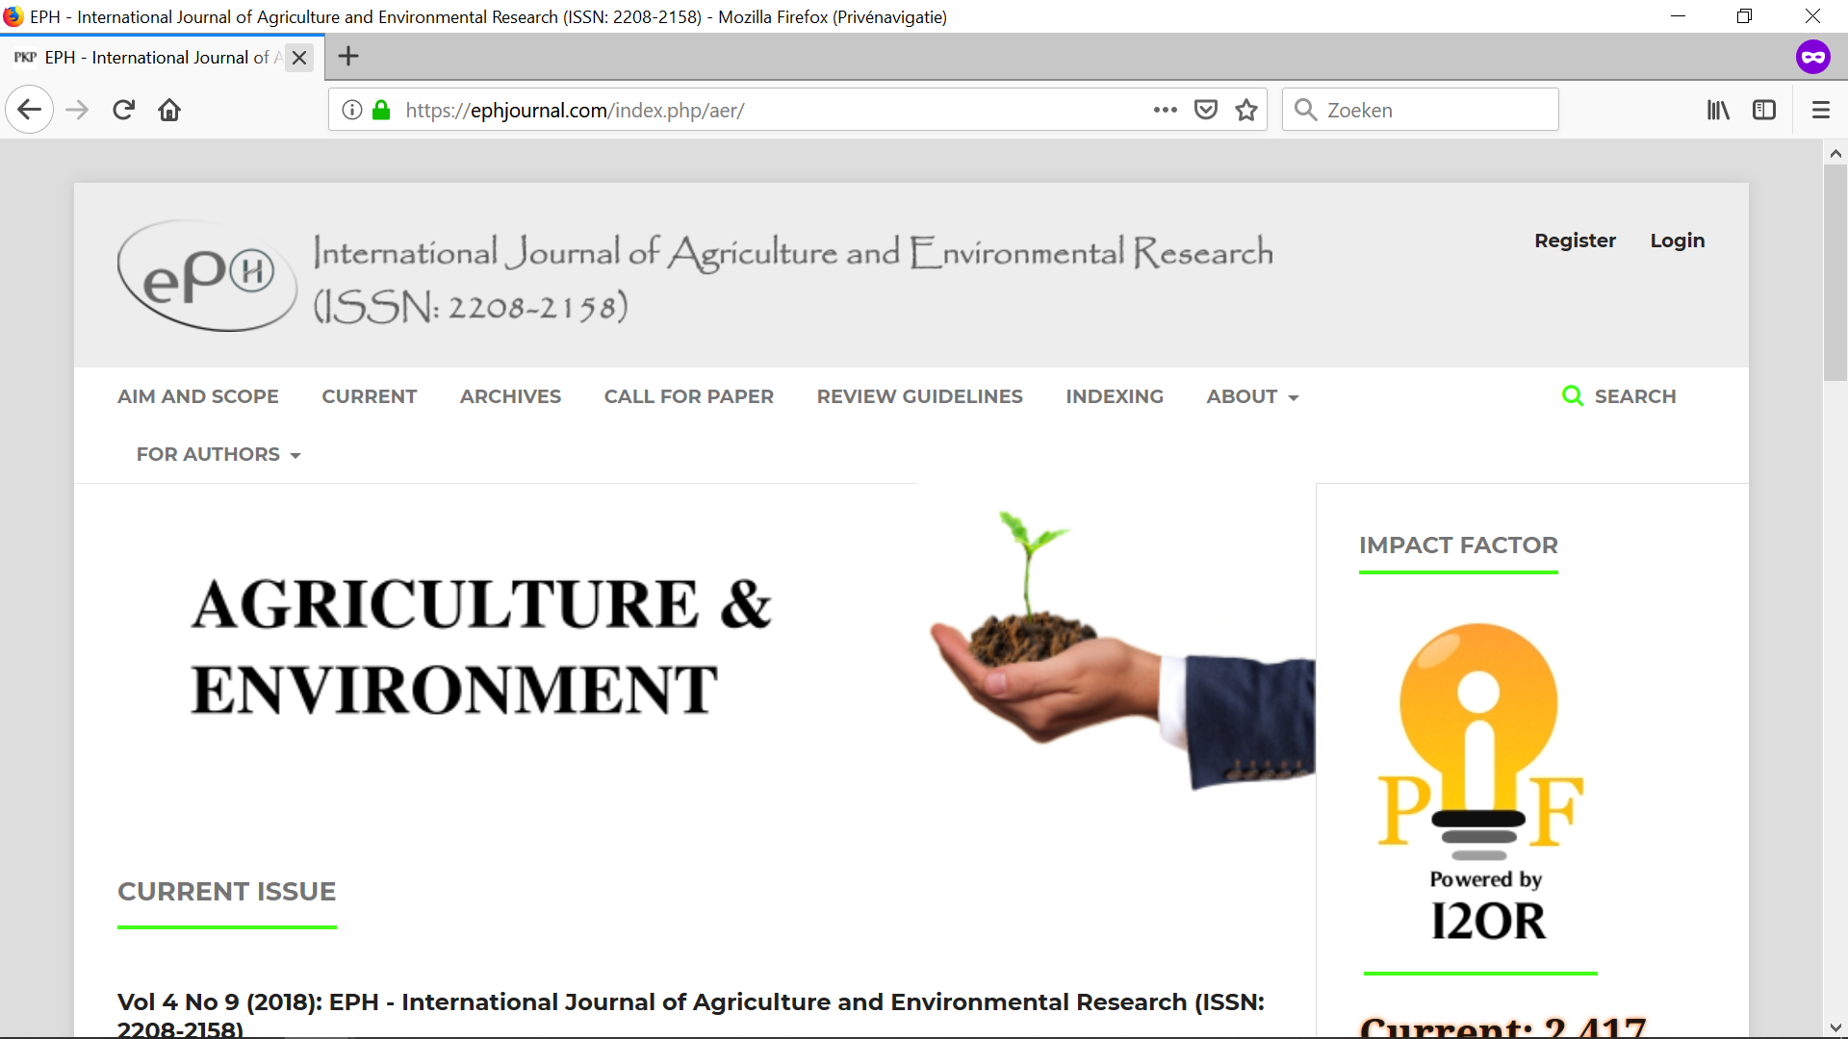
3. Predatory journals

Slide 22
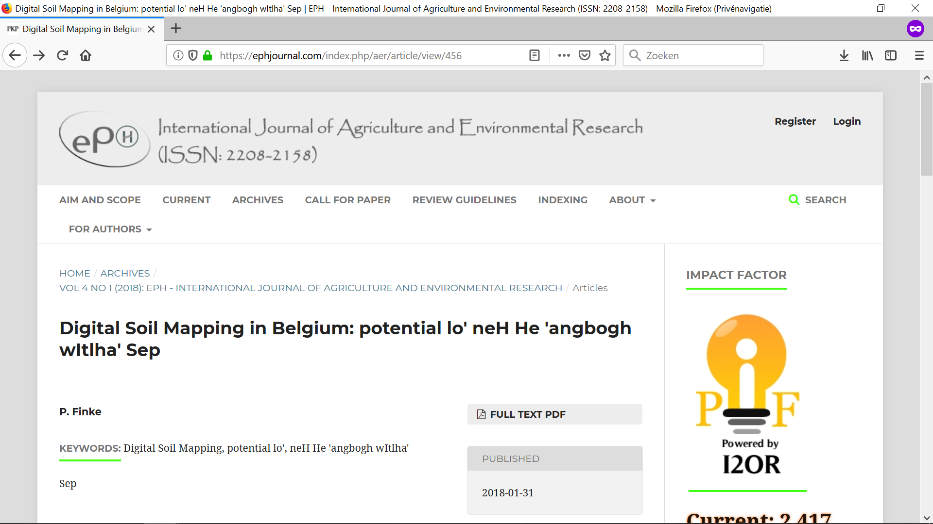
3. Predatory journals

Slide 23


Slide 24
3. Predatory journals

Slide 25

3. Predatory journals
Predatory journals and the pitfalls of publishing there
In the long run, publishing there will seriously harm your scientific reputation and career.
What do you choose?
American Journal of Advanced Agricultural Research (AJAAR)
Australian Journal of Basic and Applied Sciences
European Journal of Biotechnology and Bioscience
Indian Journal of Scientific Research and Technology (INDJSRT)
International Journal of Agriculture and Environmental Research (IJAER)
...
Soil Biology & Biochemistry
https://www.youtube.com/watch?v=RkIuWHgVtxQ
https://predatoryjournals.com/journals/
Notes:
Better one excellent paper than 50 meaningless papers that no one will ever read: this is in the international scientific scene certainly the case!!

Slide 26

Thank you for your attention
Terima kasih atas perhatiannya

